Slide 1

Helm Kubernetes packaging manager
Sit Dolor Amet

Slide 2
HELM IN ACTION

Slide 3
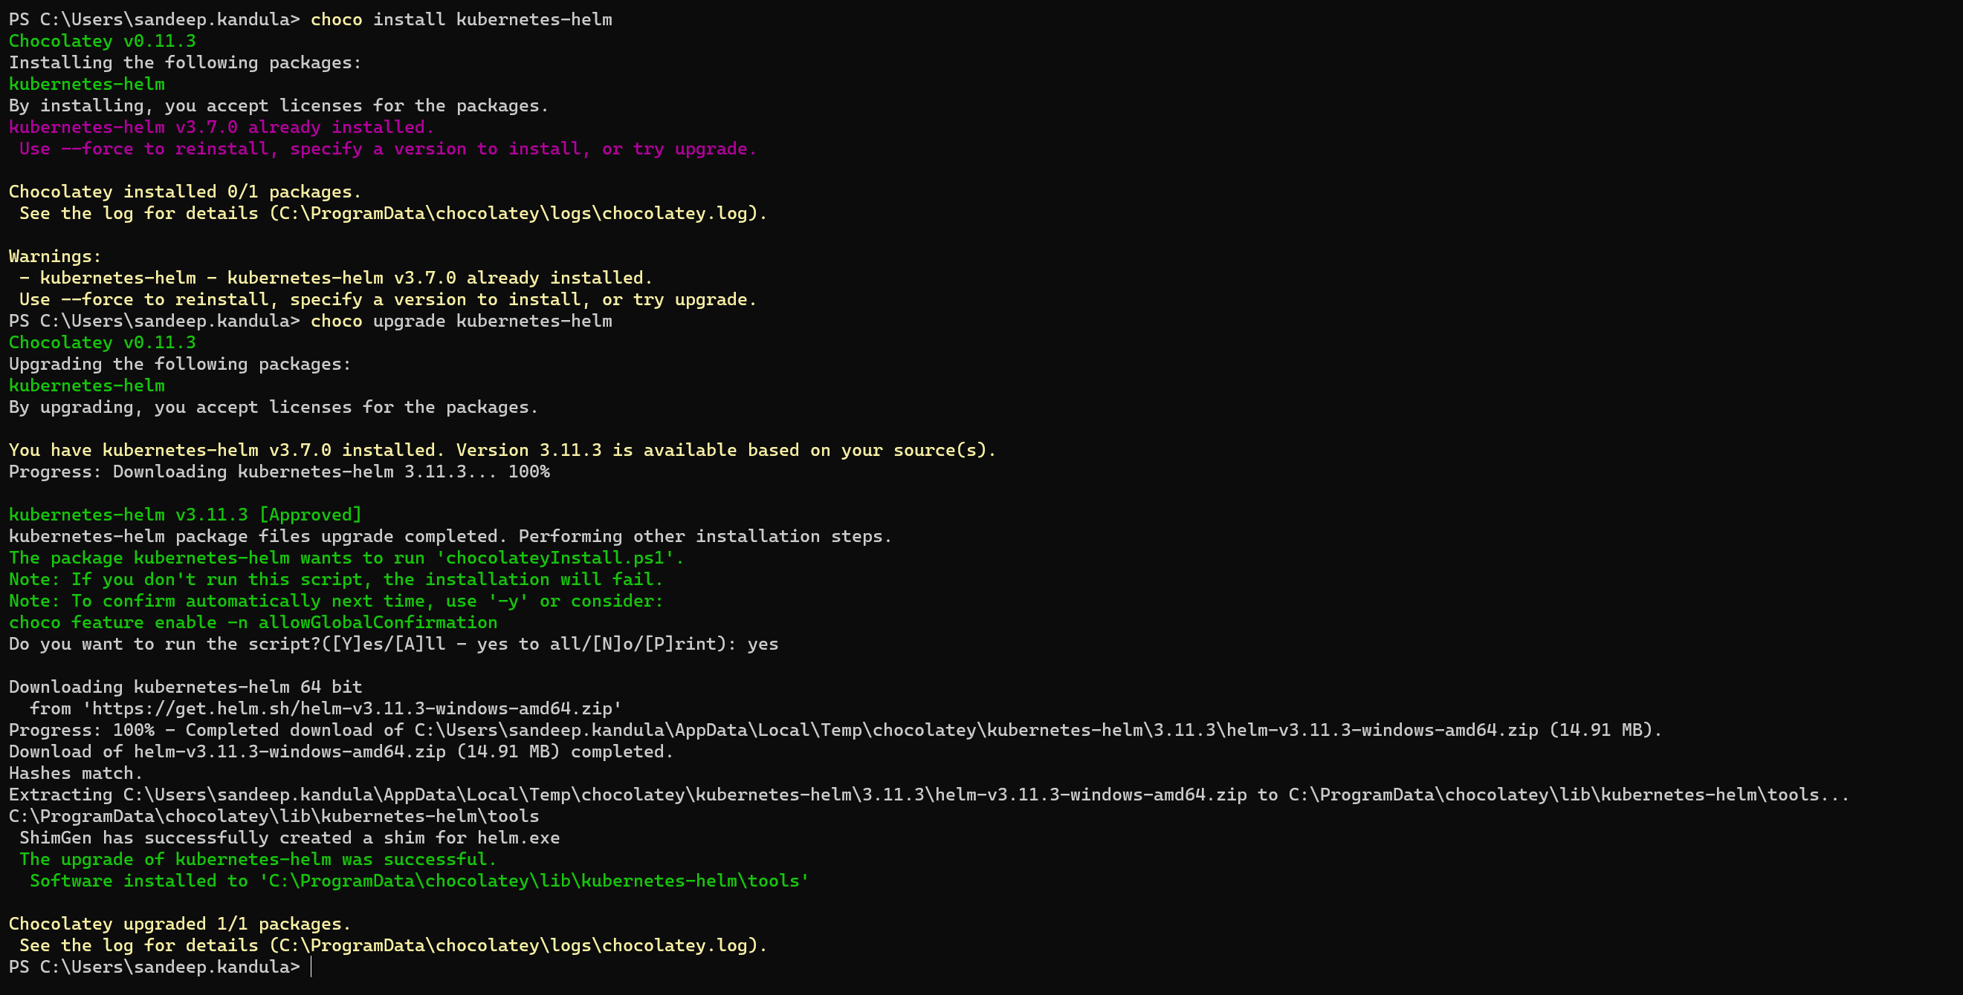

Slide 4
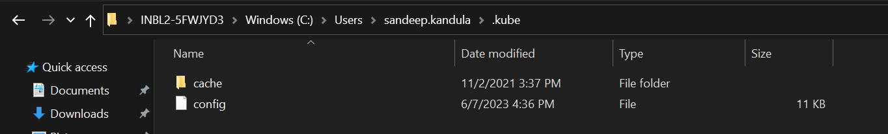
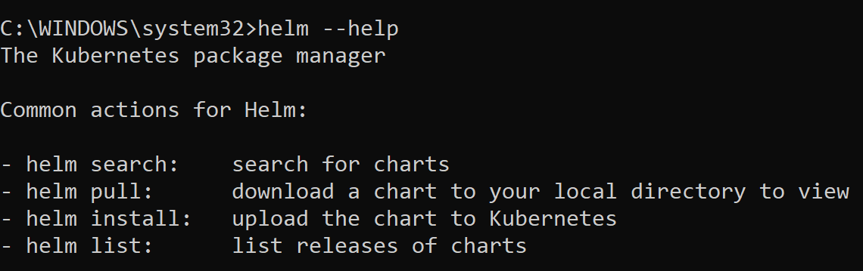
Kube config folder location

Slide 5
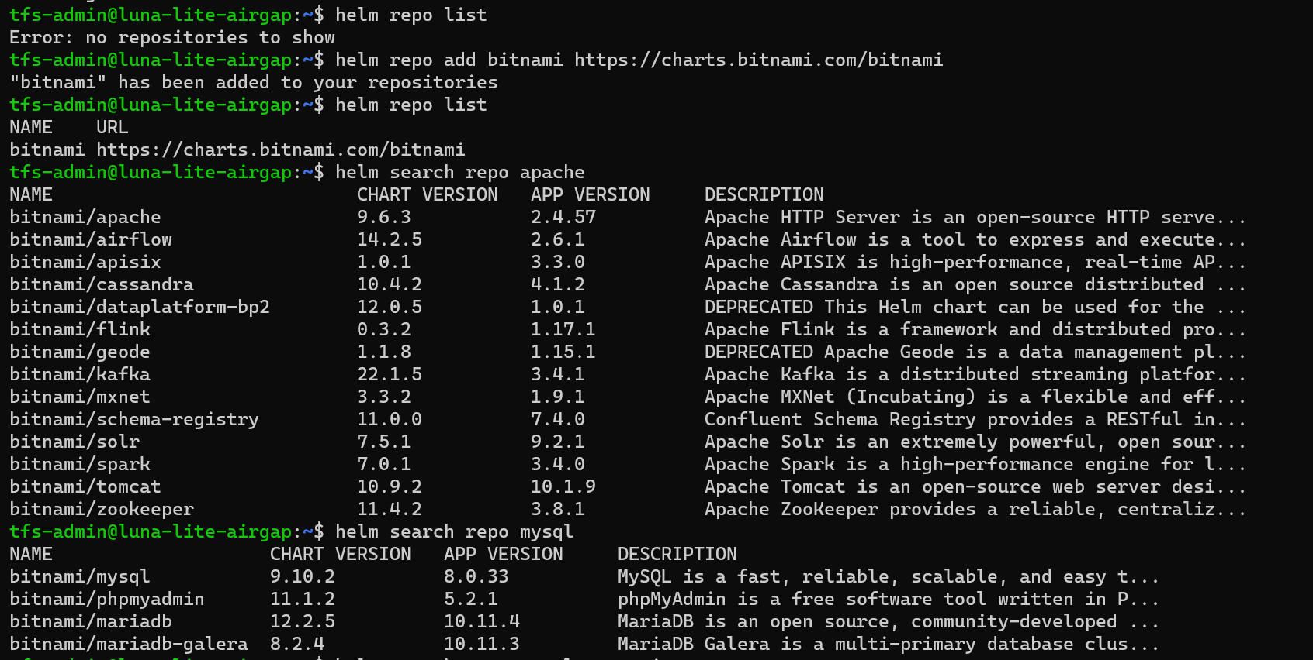
Helm Commands -1

Slide 6
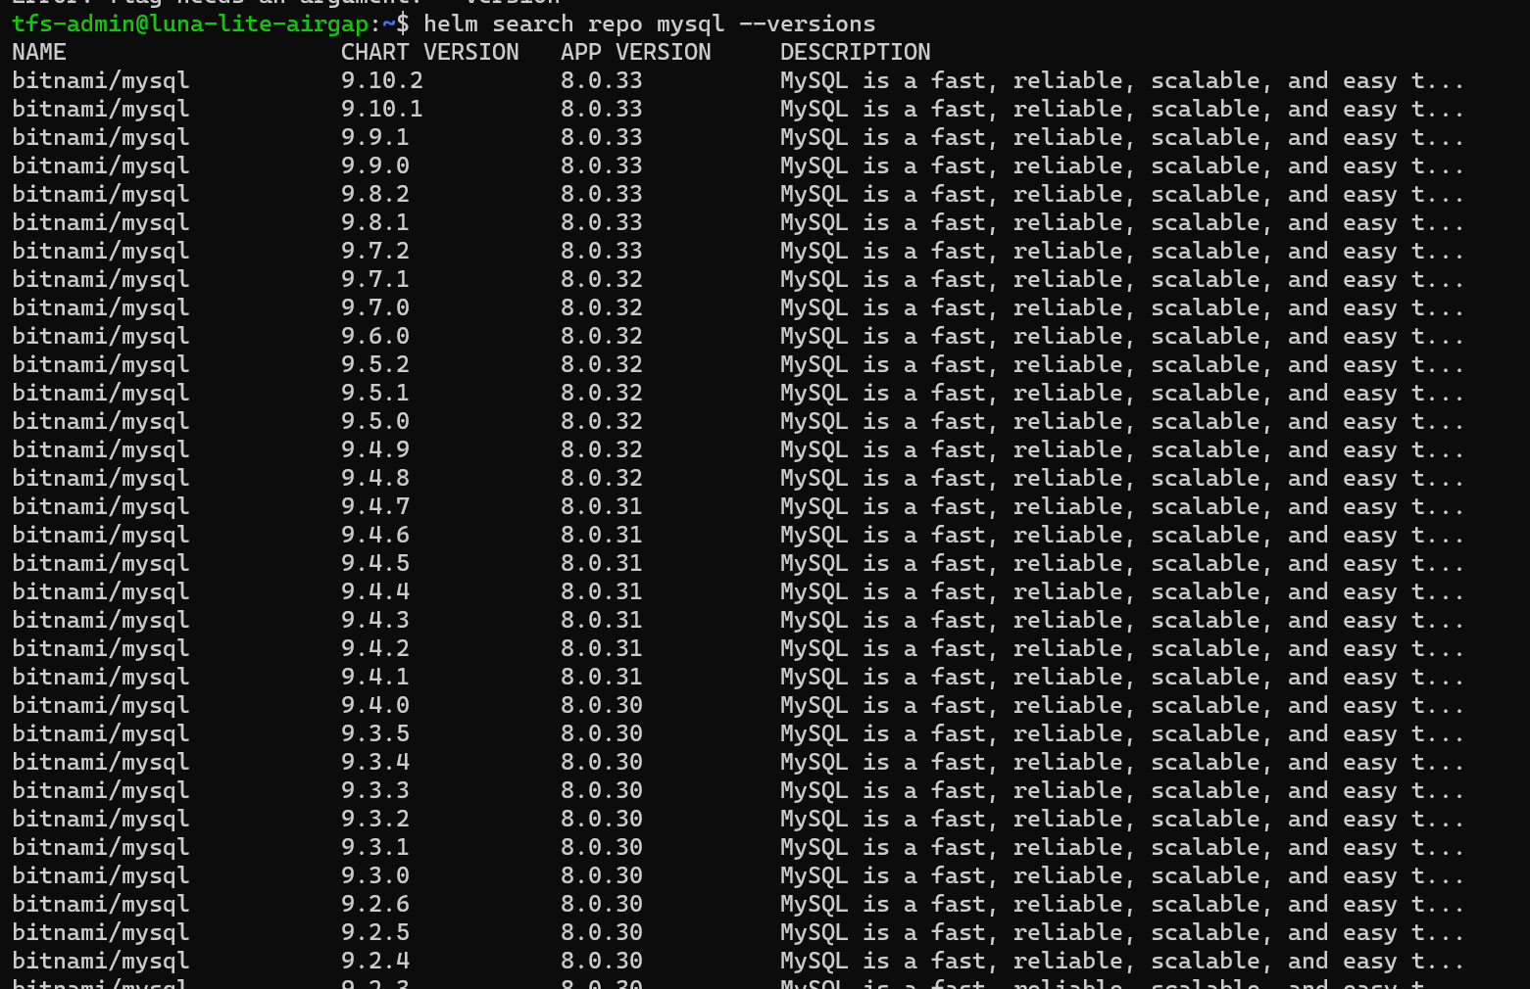
Helm Commands -2

Slide 7
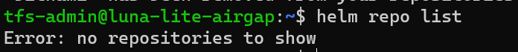
Helm Commands -4

Slide 8
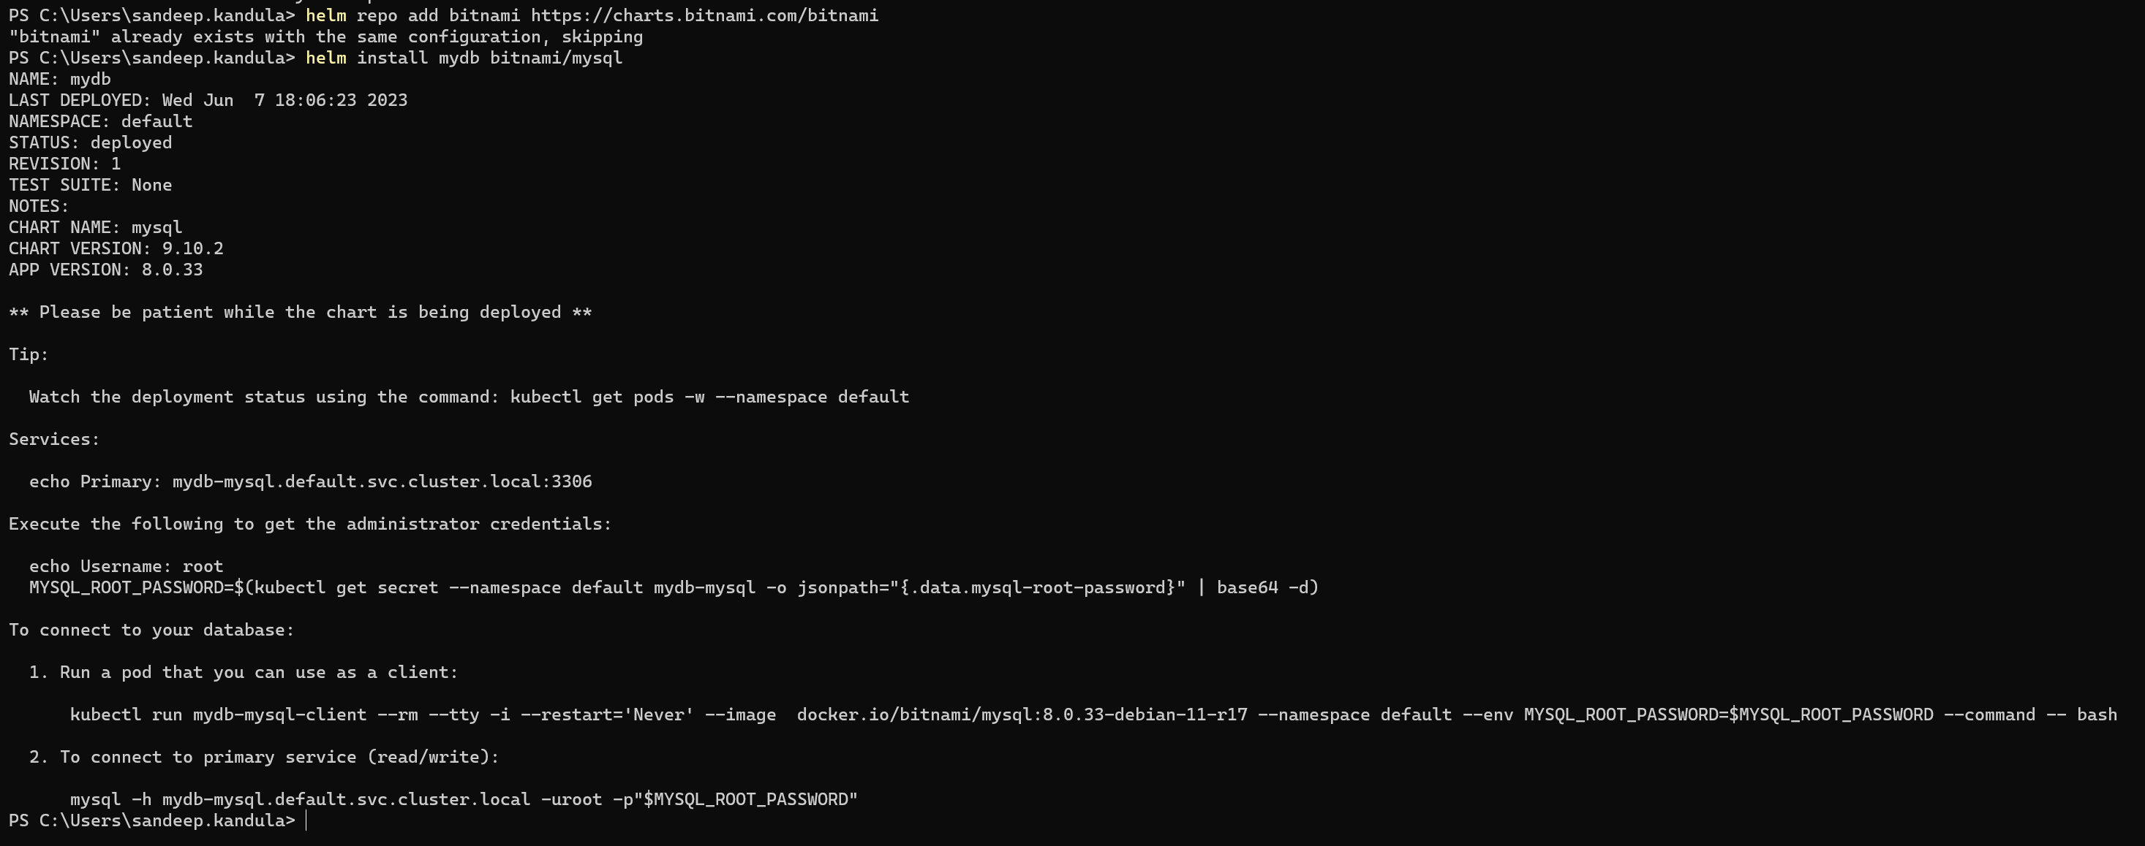
INSTALL BITNAMI/MYSQL
Notes:
helm install mydb bitnami/mysql
NAME: mydb
LAST DEPLOYED: Wed Jun 7 18:06:23 2023
NAMESPACE: default
STATUS: deployed
REVISION: 1
TEST SUITE: None
NOTES:
CHART NAME: mysql
CHART VERSION: 9.10.2
APP VERSION: 8.0.33
** Please be patient while the chart is being deployed **
Tip:
Watch the deployment status using the command: kubectl get pods -w --namespace default
Services:
echo Primary: mydb-mysql.default.svc.cluster.local:3306
Execute the following to get the administrator credentials:
echo Username: root
MYSQL_ROOT_PASSWORD=$(kubectl get secret --namespace default mydb-mysql -o jsonpath="{.data.mysql-root-password}" | base64 -d)
To connect to your database:
1. Run a pod that you can use as a client:
kubectl run mydb-mysql-client --rm --tty -i --restart='Never' --image docker.io/bitnami/mysql:8.0.33-debian-11-r17 --namespace default --env MYSQL_ROOT_PASSWORD=$MYSQL_ROOT_PASSWORD --command -- bash
2. To connect to primary service (read/write):
mysql -h mydb-mysql.default.svc.cluster.local -uroot -p"$MYSQL_ROOT_PASSWORD"

Slide 9
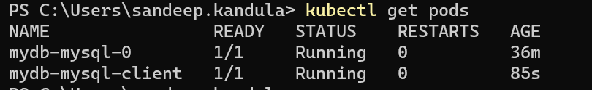
MYSQL - 1
Notes:
echo MYSQL_ROOT_PASSWORD=$(kubectl get secret --namespace default mydb-mysql -o jsonpath="{.data.mysql-root-password}")
MYSQL_ROOT_PASSWORD=OHA3YUJURXI2Nw==
8p7aBTEr67
mysql -h mydb-mysql.default.svc.cluster.local -uroot –p8p7aBTEr67

Slide 10
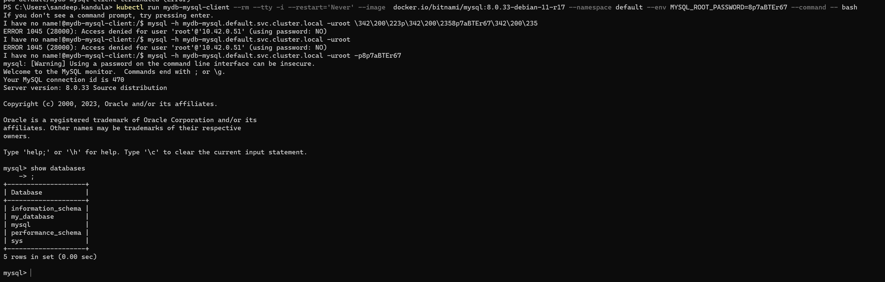
MYSQL - 2
Notes:
echo MYSQL_ROOT_PASSWORD=$(kubectl get secret --namespace default mydb-mysql -o jsonpath="{.data.mysql-root-password}")
MYSQL_ROOT_PASSWORD=OHA3YUJURXI2Nw==
8p7aBTEr67
mysql -h mydb-mysql.default.svc.cluster.local -uroot –p8p7aBTEr67

Slide 11
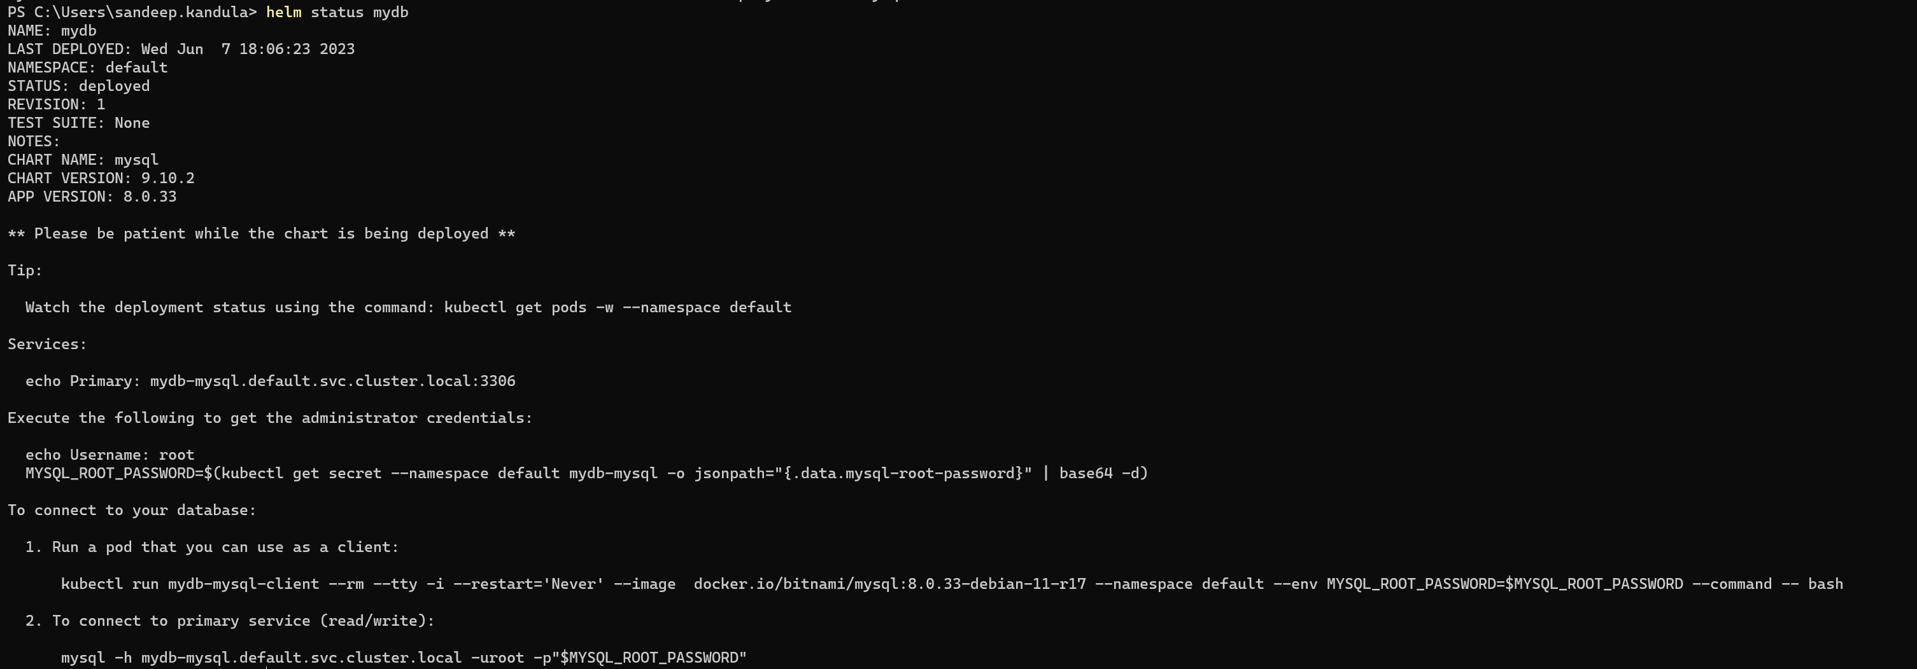
HELM STATUS

Slide 12
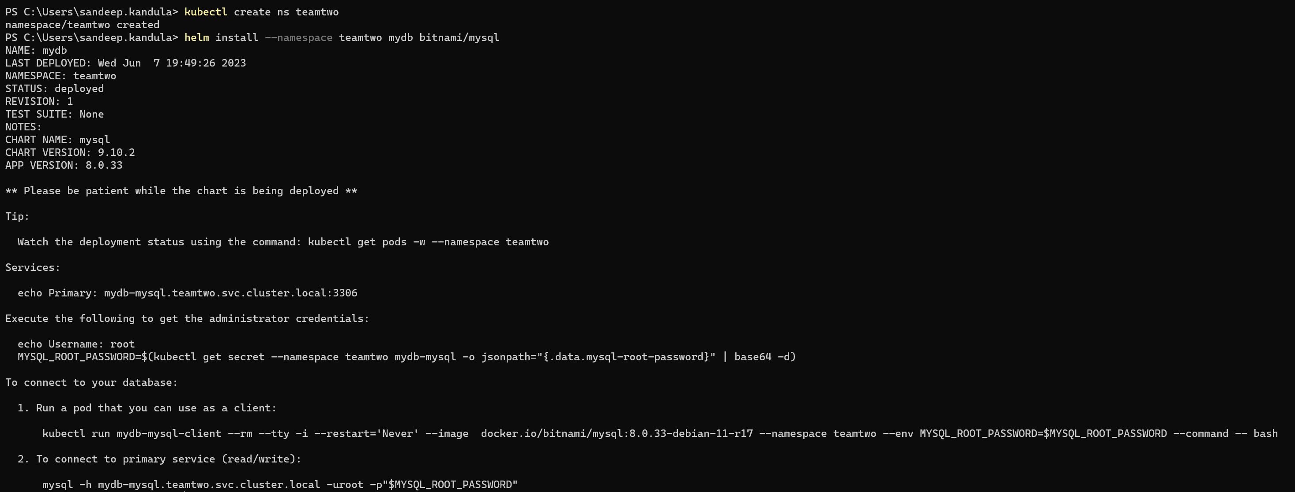
Helm install in separate NAMESPACE

Slide 13
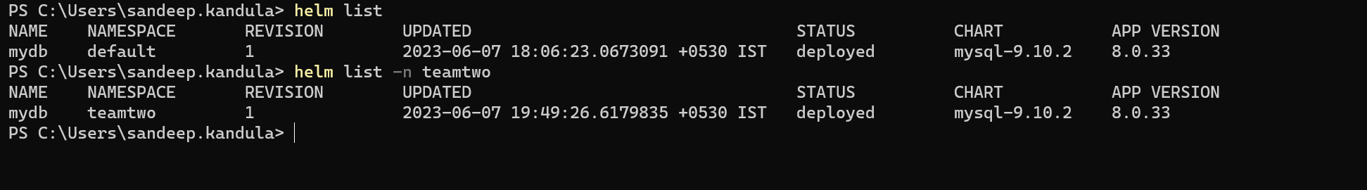
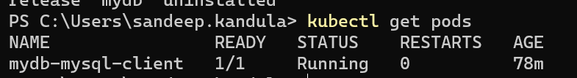
HELM LIST and uninstall - 1

Slide 14
HELM LIST and uninstall - 2

Slide 15
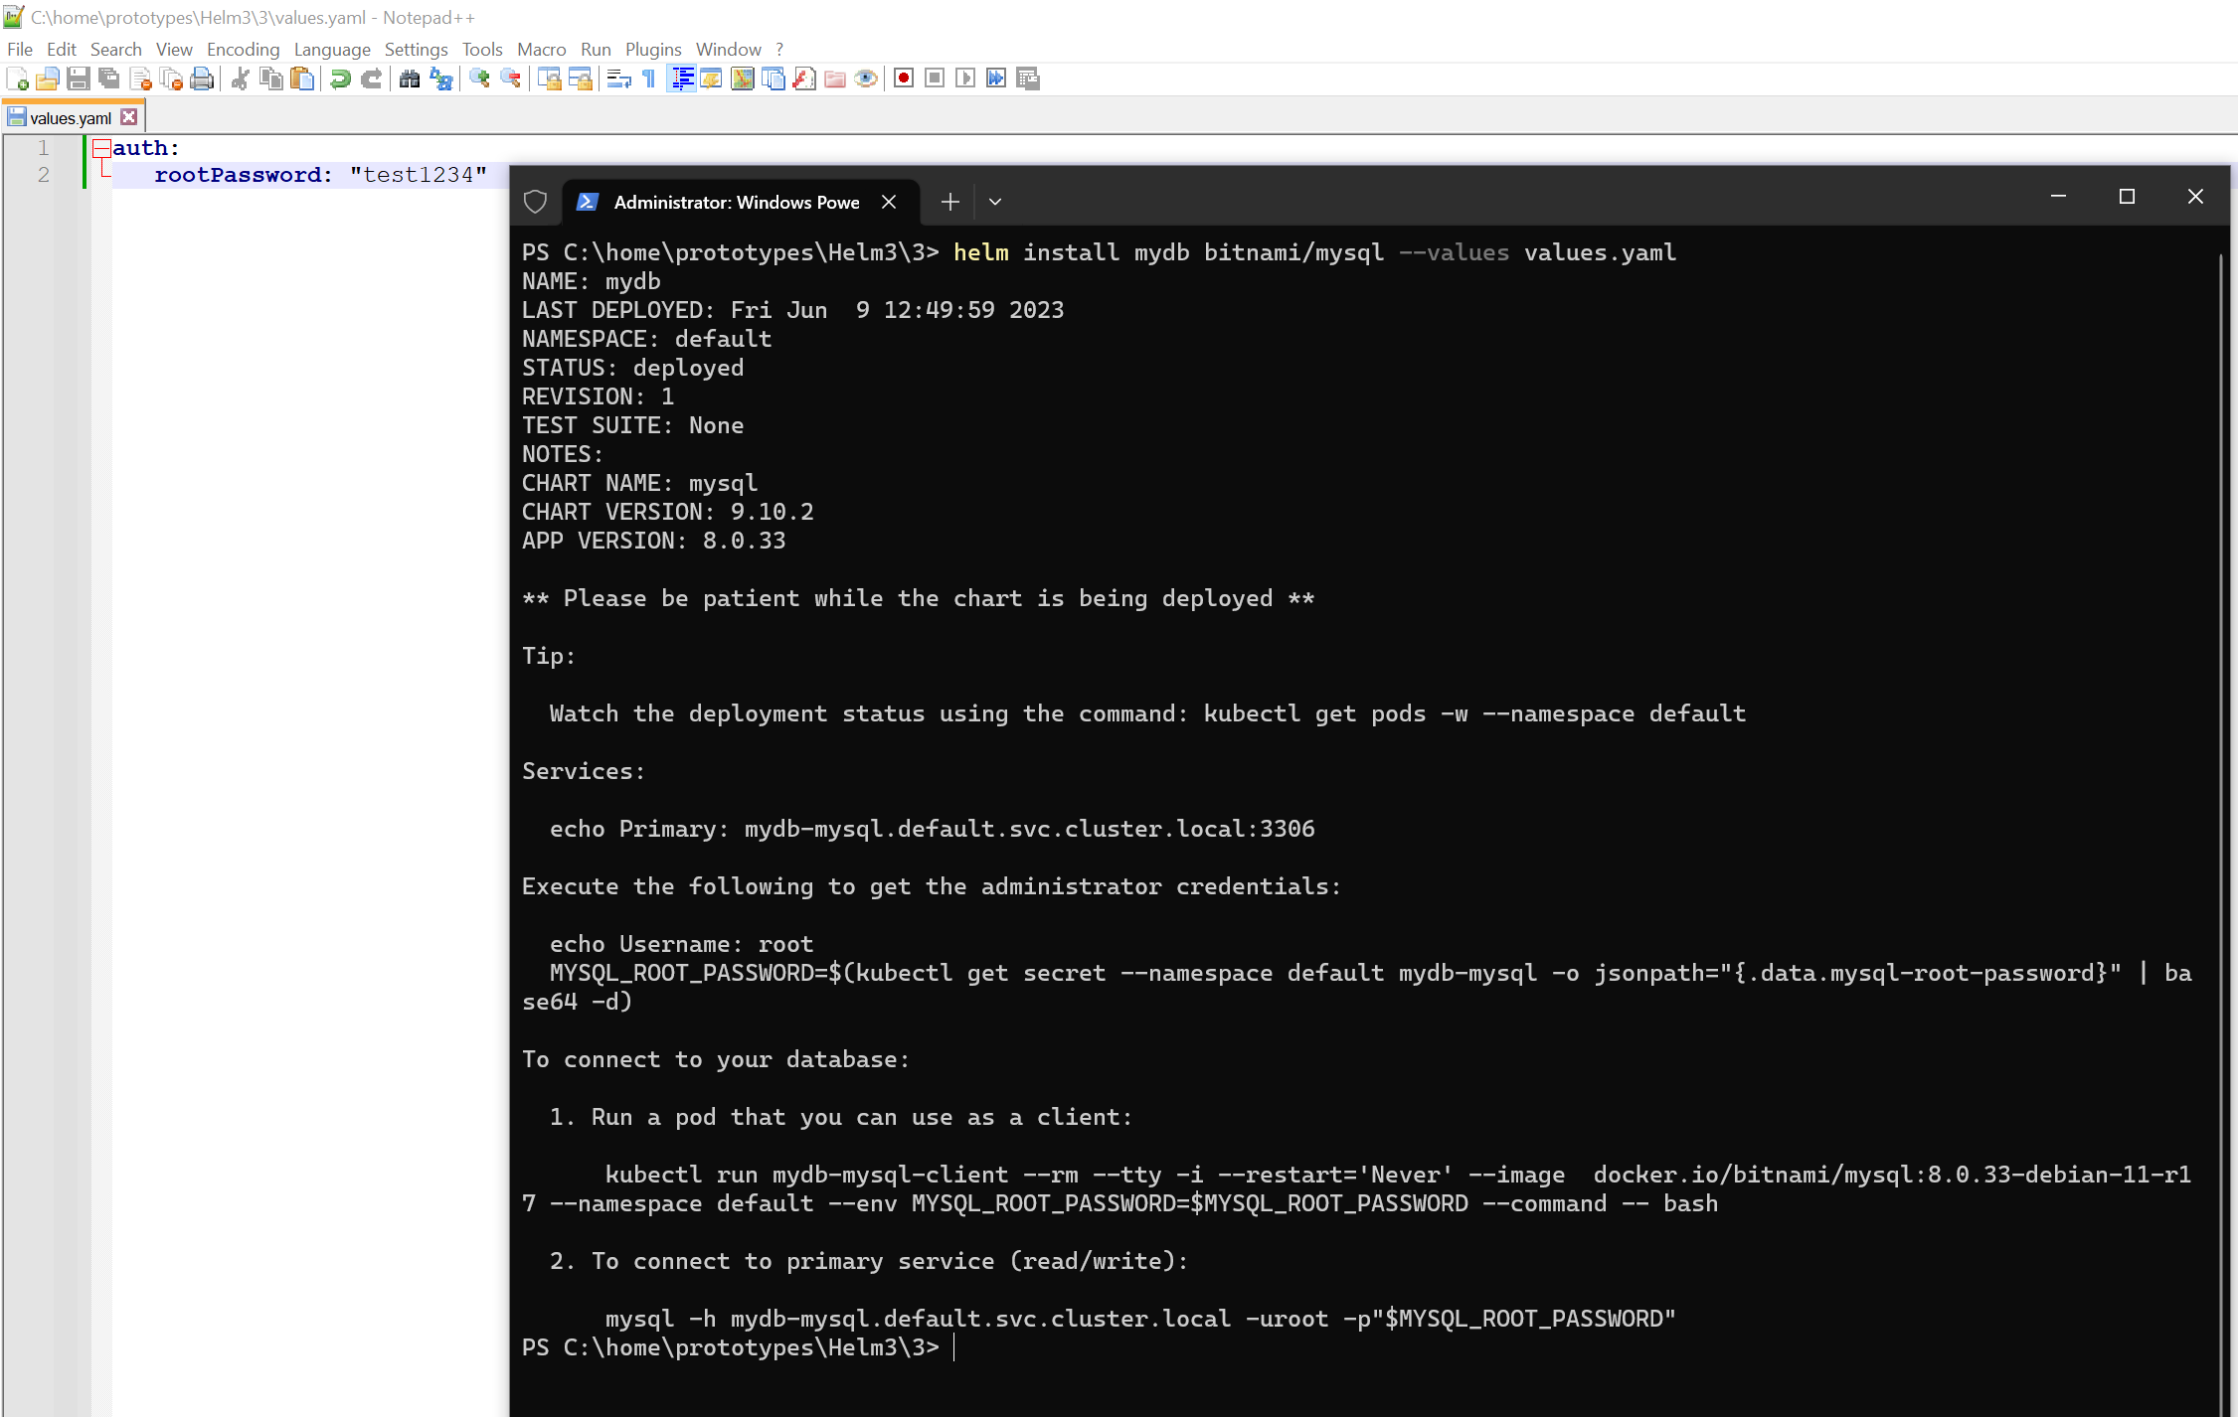
Providing custom values
Notes:
NAME: mydb
LAST DEPLOYED: Fri Jun 9 15:37:55 2023
NAMESPACE: default
STATUS: deployed
REVISION: 1
TEST SUITE: None
NOTES:
CHART NAME: mysql
CHART VERSION: 9.10.2
APP VERSION: 8.0.33
** Please be patient while the chart is being deployed **
Tip:
Watch the deployment status using the command: kubectl get pods -w --namespace default
Services:
echo Primary: mydb-mysql.default.svc.cluster.local:3306
Execute the following to get the administrator credentials:
echo Username: root
MYSQL_ROOT_PASSWORD=$(kubectl get secret --namespace default mydb-mysql -o jsonpath="{.data.mysql-root-password}" | base64 -d)
To connect to your database:
1. Run a pod that you can use as a client:
kubectl run mydb-mysql-client --rm --tty -i --restart='Never' --image docker.io/bitnami/mysql:8.0.33-debian-11-r17 --namespace default --env MYSQL_ROOT_PASSWORD=$MYSQL_ROOT_PASSWORD --command -- bash
2. To connect to primary service (read/write):
mysql -h mydb-mysql.default.svc.cluster.local -uroot -p"$MYSQL_ROOT_PASSWORD"

Slide 17
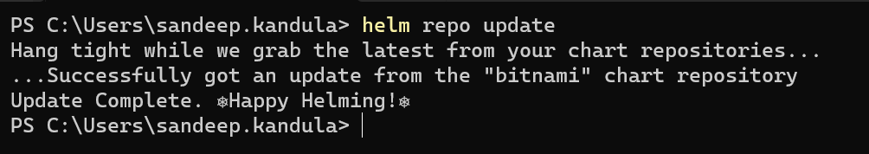
HELM UPGRADE - 1

Slide 18
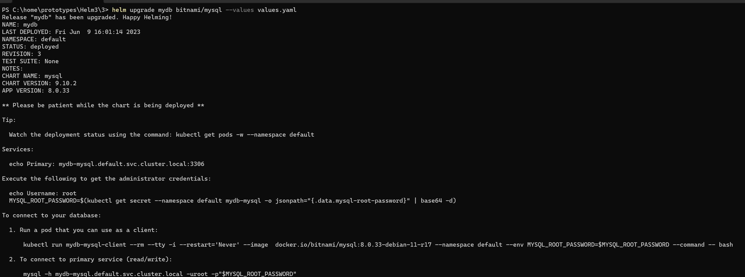
HELM UPGRADE - 2
helm upgrade mydb bitnami/mysql --reusevalues

Slide 19
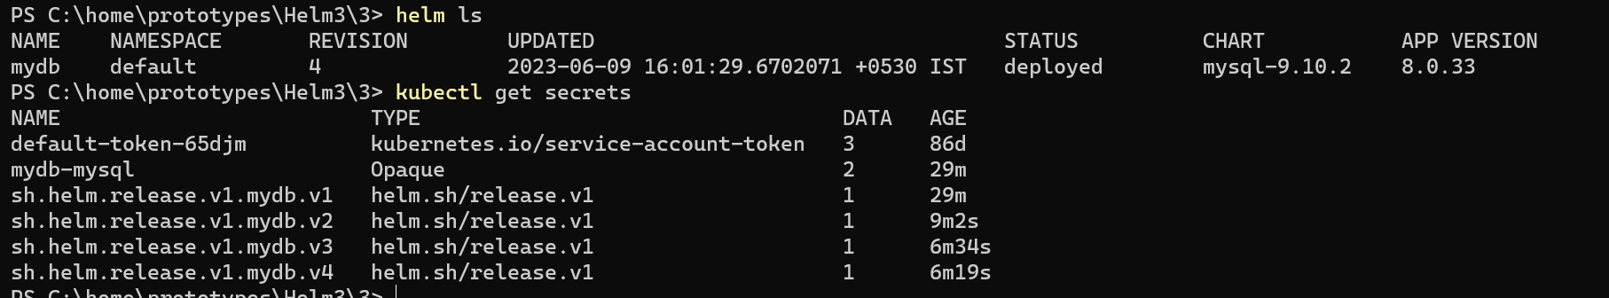
Release records

Slide 20
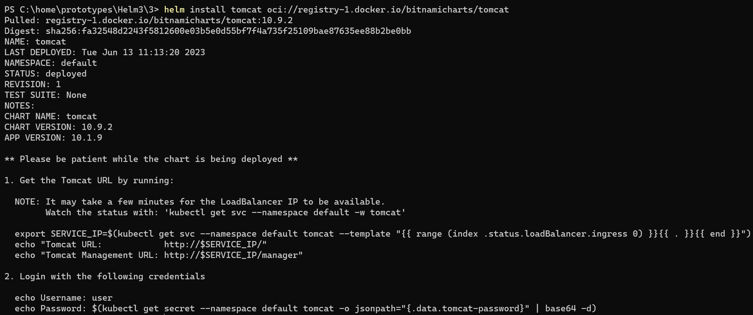
Assignment update - 1
tomcat 10.9.2 · bitnami/bitnami (artifacthub.io)

Slide 21
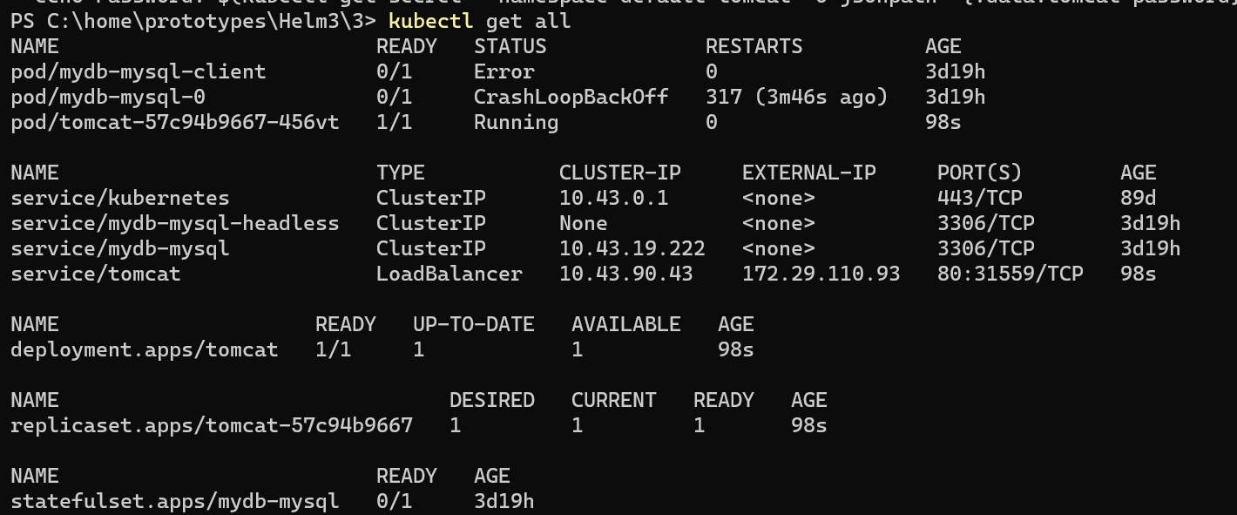
Assignment update - 2

Slide 22
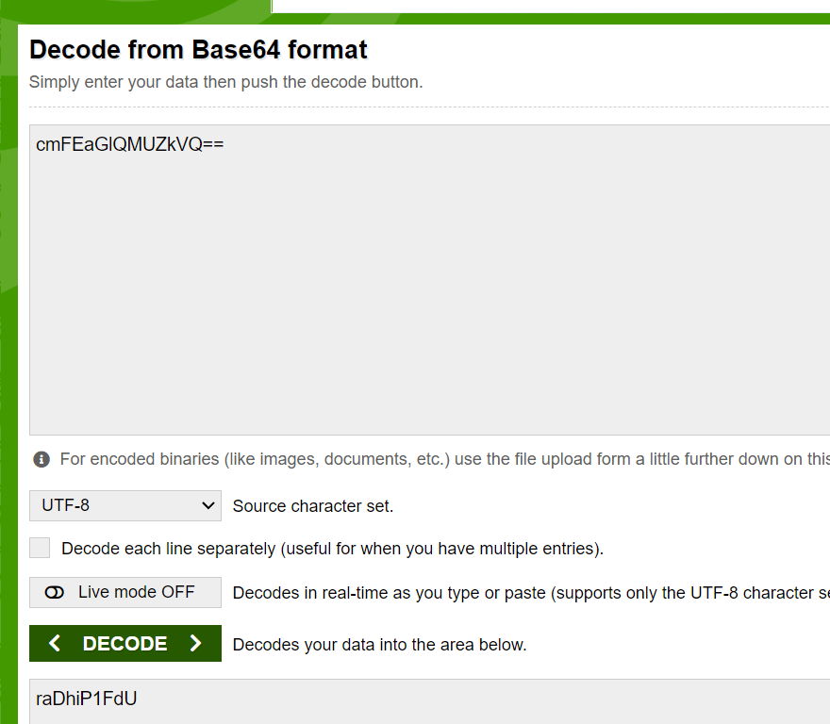
Assignment update - 3
Notes:
raDhiP1FdU

Slide 23
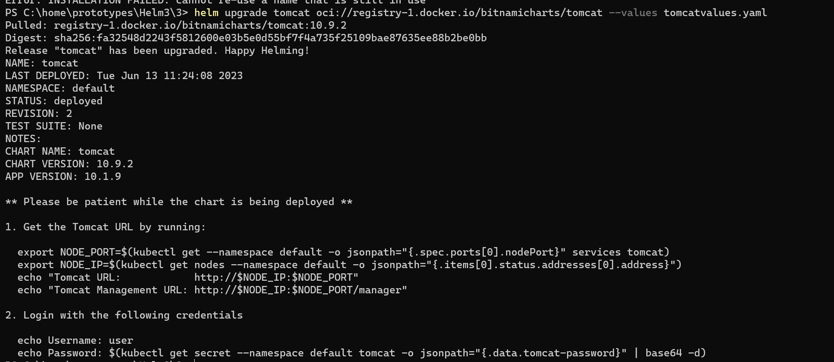
Assignment update - 4

Slide 24
Assignment update - 5

Slide 25
ADVANCED COMMANDS

Slide 26
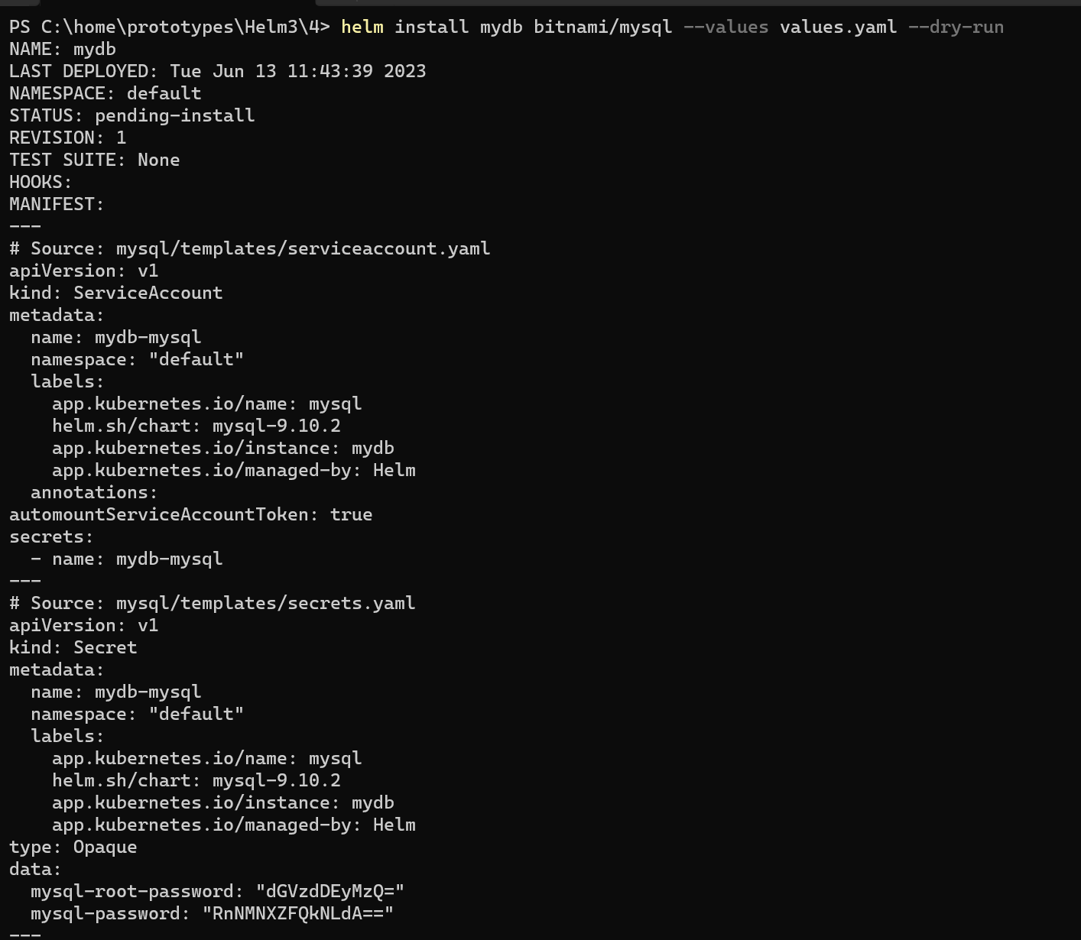
Dry run

Slide 27
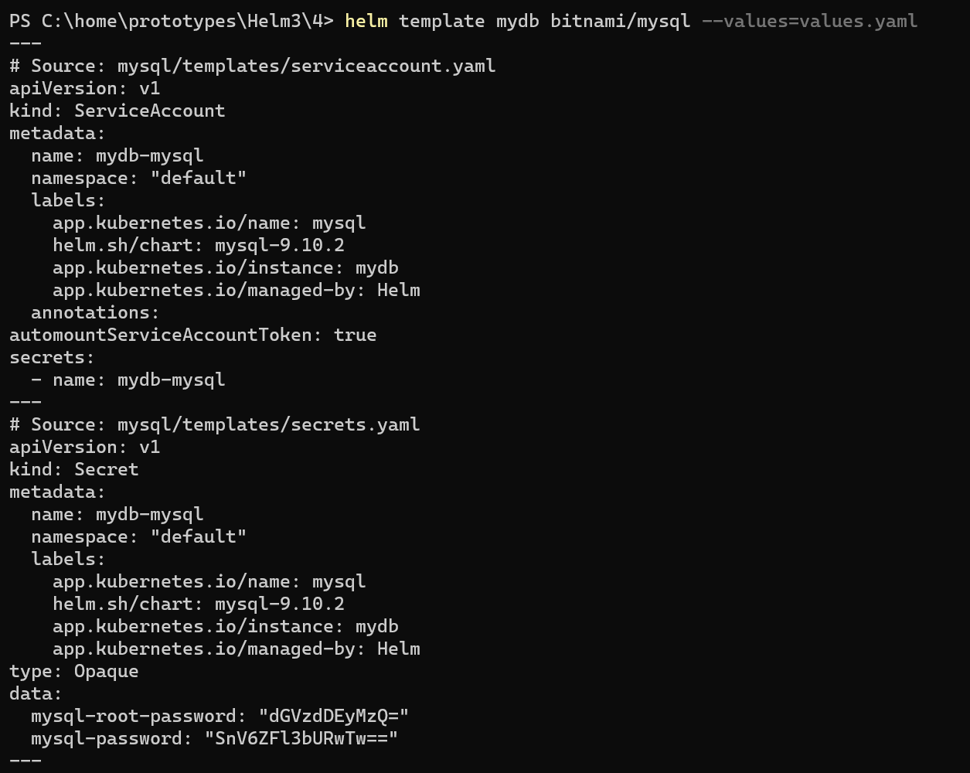
Helm template

Slide 28
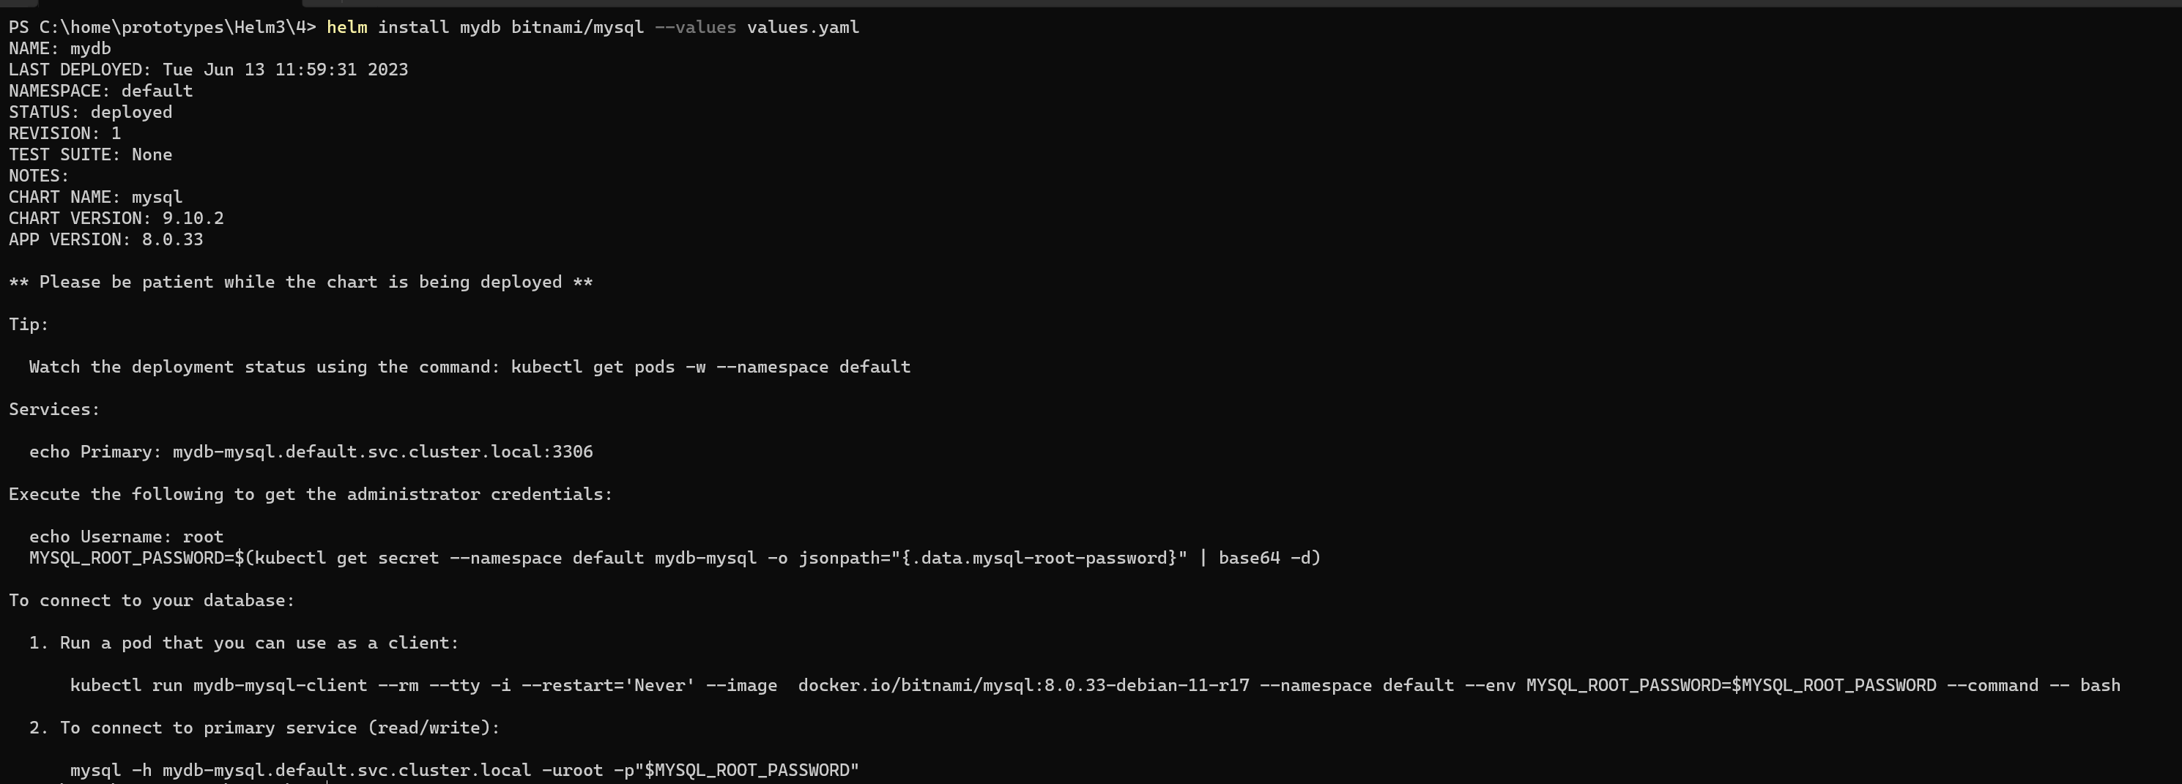
Release records - 1

Slide 29
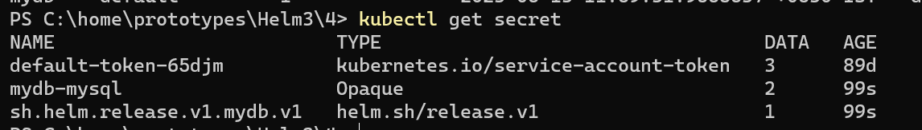
Release records - 2

Slide 30
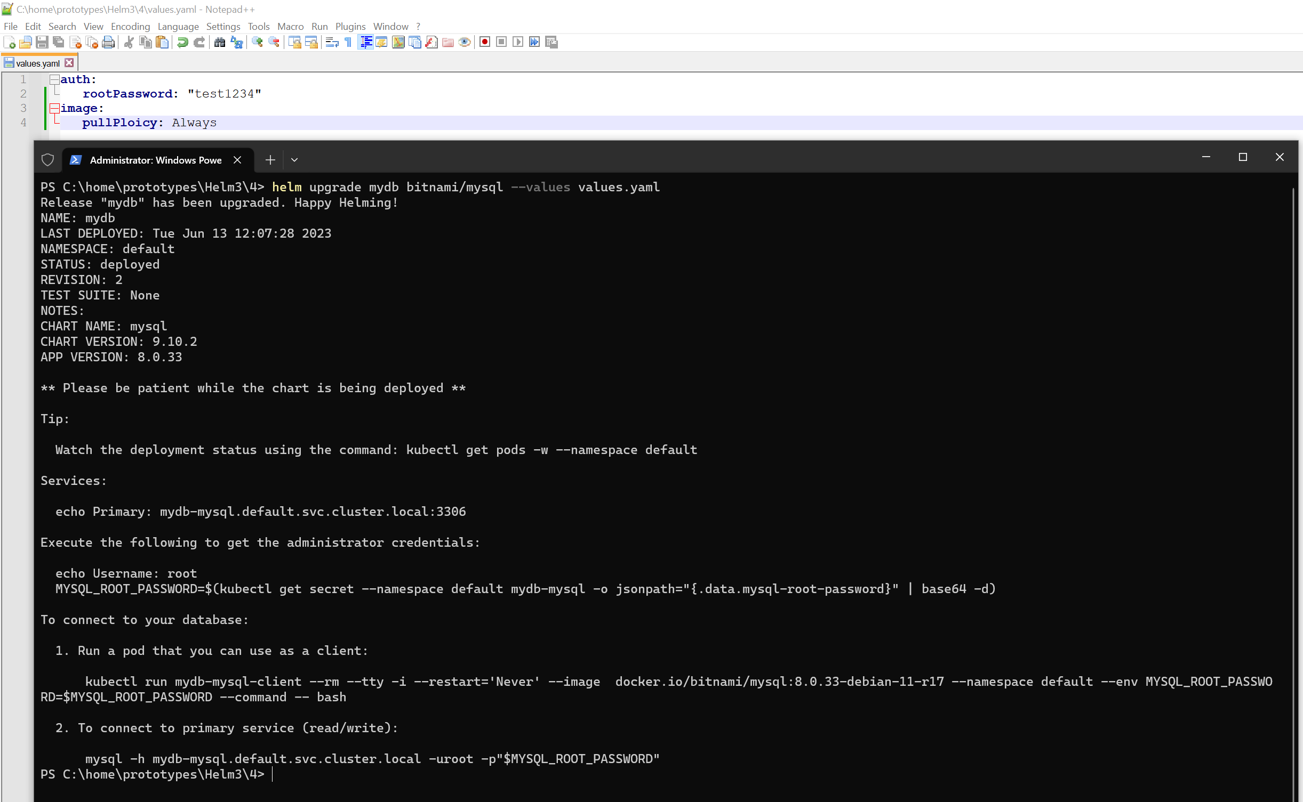
Release records - 3

Slide 31
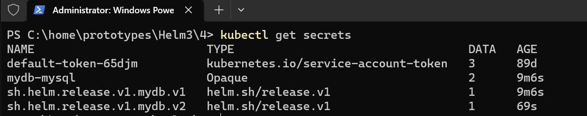
Release records - 4

Slide 32
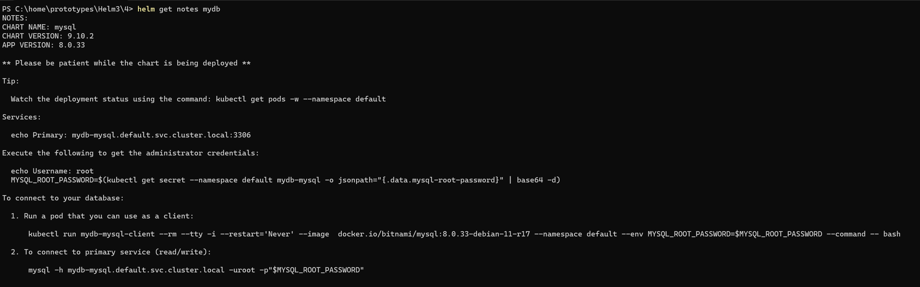
HELM GET -1

Slide 33
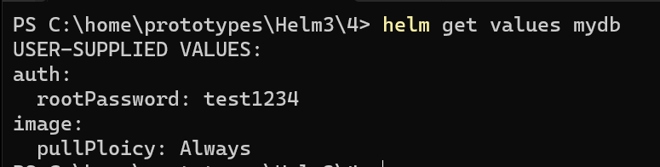
HELM GET -2

Slide 34
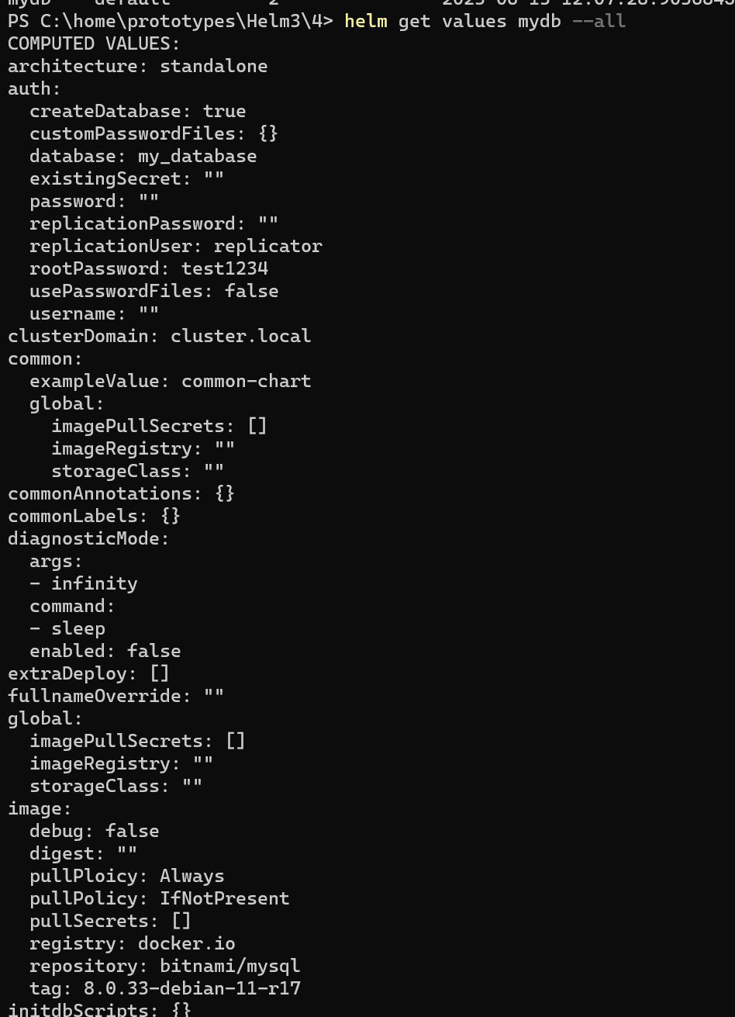
HELM GET -3

Slide 35
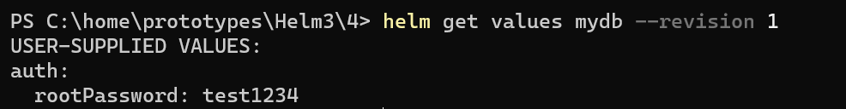
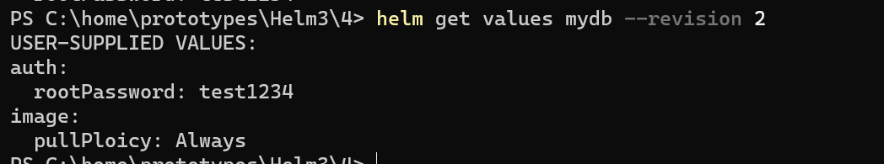
HELM GET -4

Slide 36
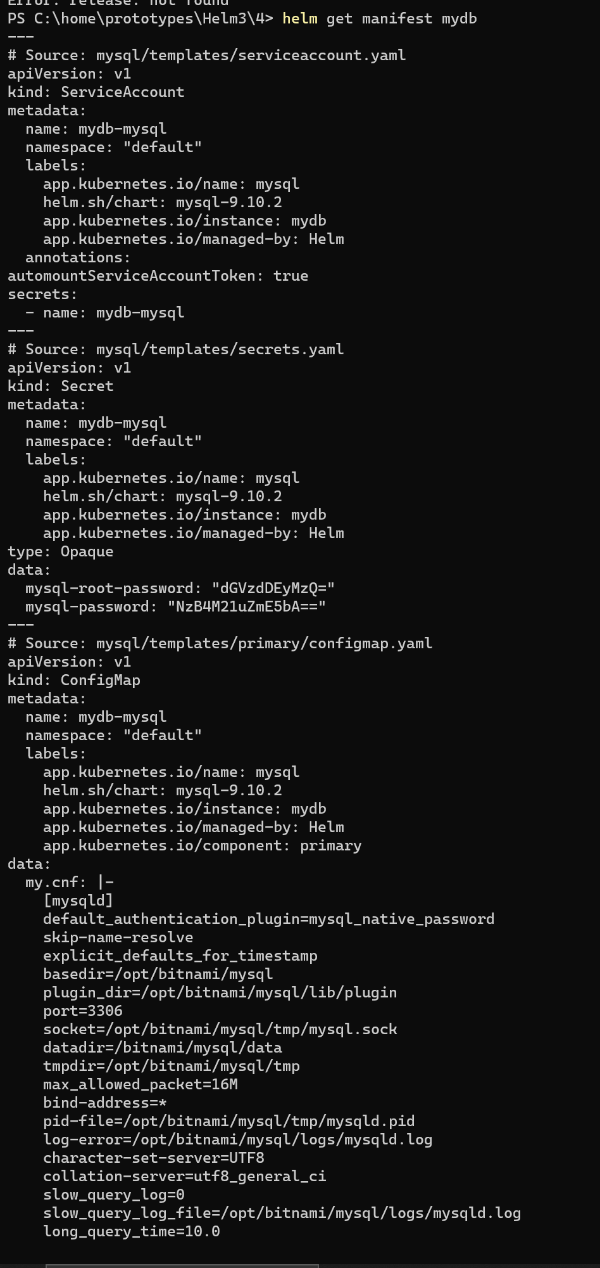
HELM GET 5

Slide 37
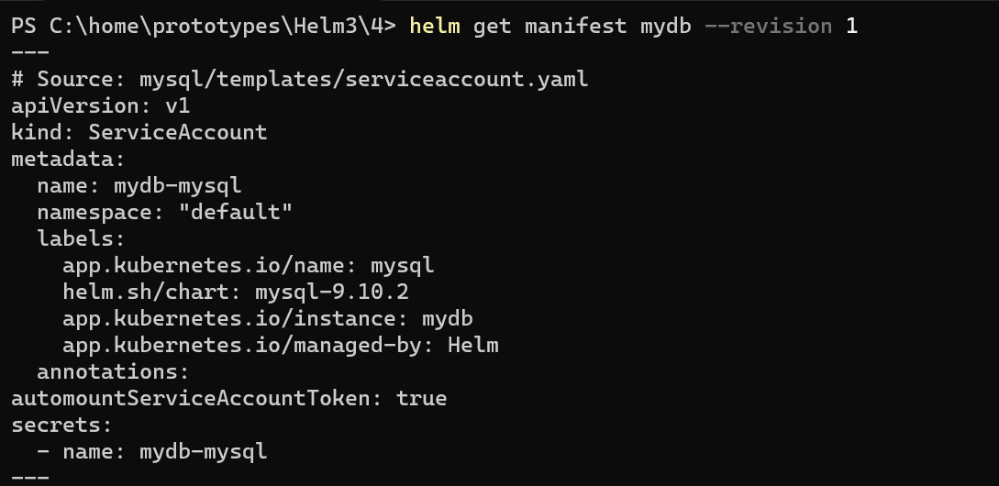
HELM GET 6

Slide 38
HELM GET 7

Slide 39
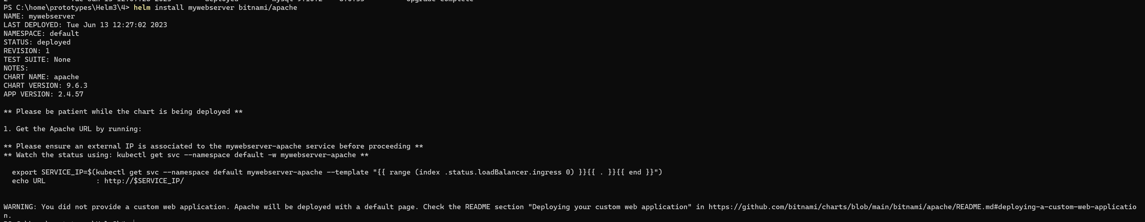
HELM INSTALL APACHE -1

Slide 40
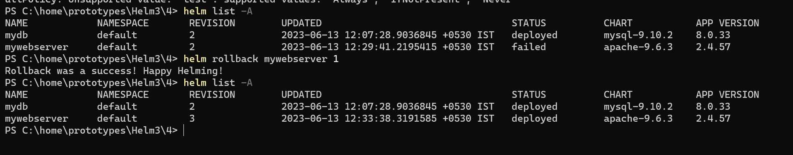
HELM INSTALL APACHE -2

Slide 41
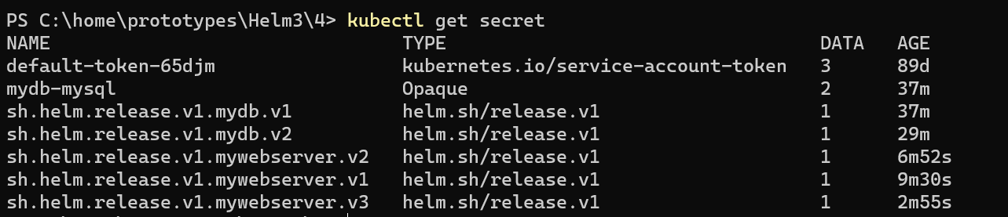
HELM INSTALL APACHE -3

Slide 42
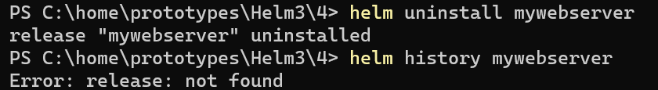
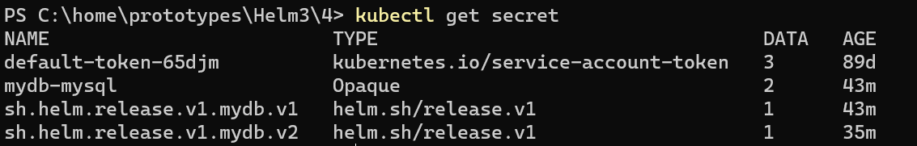
HELM INSTALL APACHE -4

Slide 43
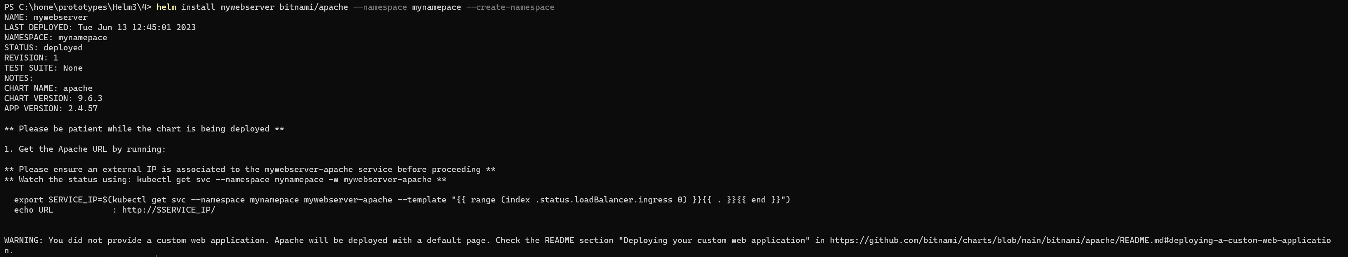
Create namespace

Slide 44
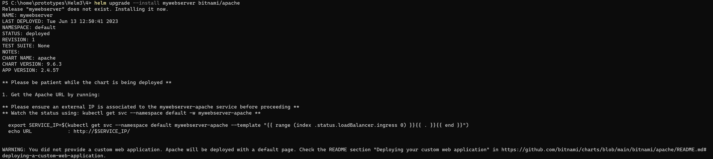
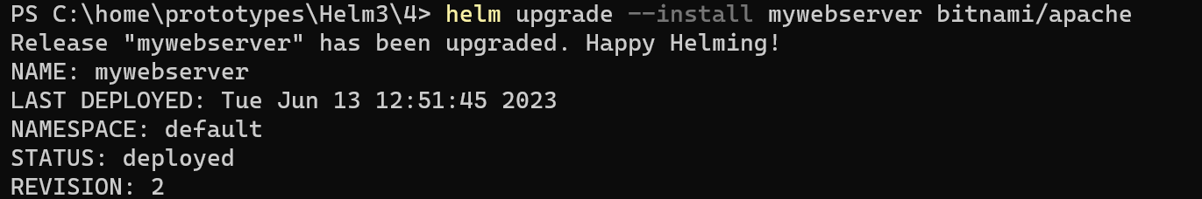
Install or upgrade

Slide 45
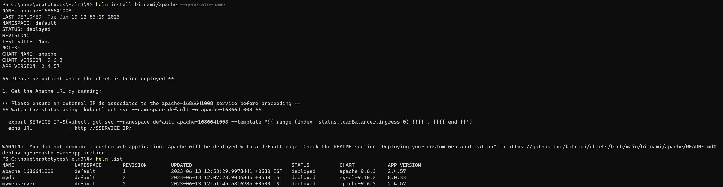
GENERATE RELEASE NAMES - 1

Slide 46
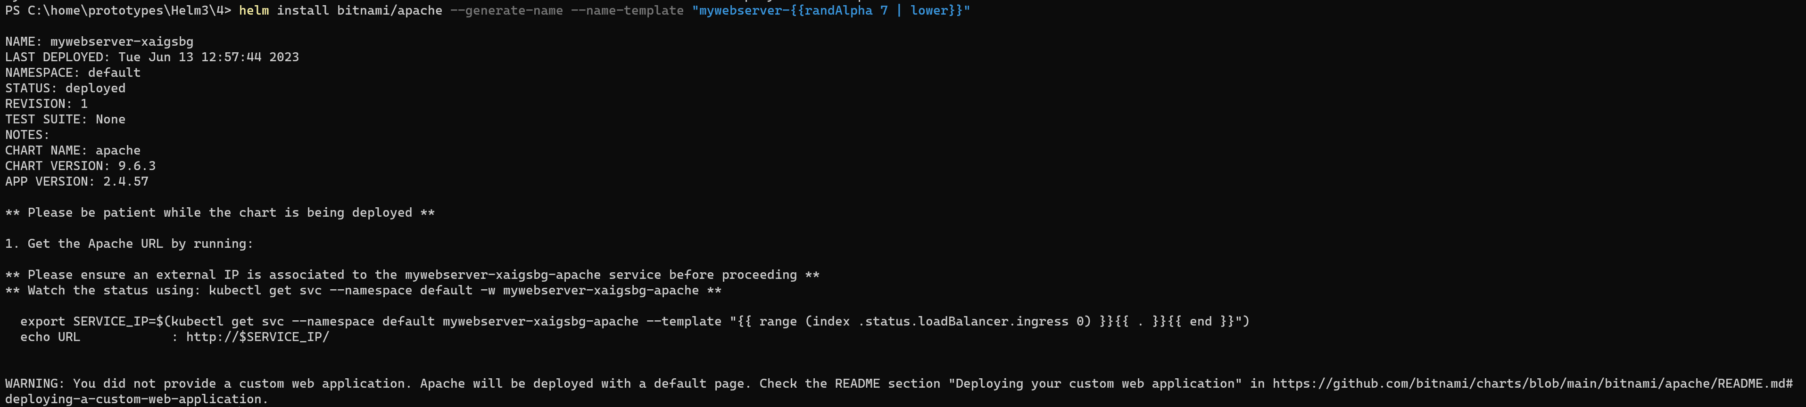
GENERATE RELEASE NAMES - 2

Slide 47
WAIT and timeout
Default time out is 5 mins
Roll back to previous version in case of failure

Slide 48
FORCE
Forcefully start the pods when you do upgrade.
Kubernetes will delete the old pods and create new ones

Slide 49
Clean up on failure

Slide 50
Create charts

Slide 51
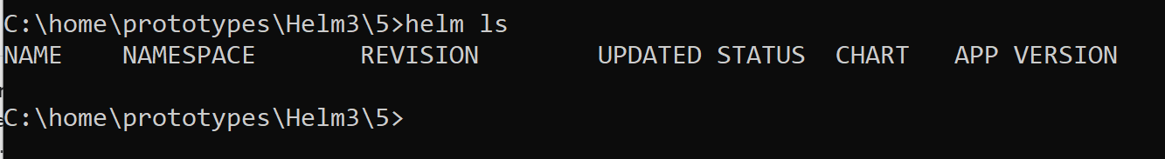
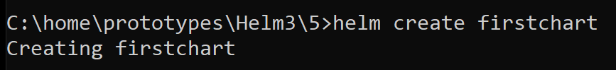
Create first chart
By default, it uses NGINX chart.

Slide 52
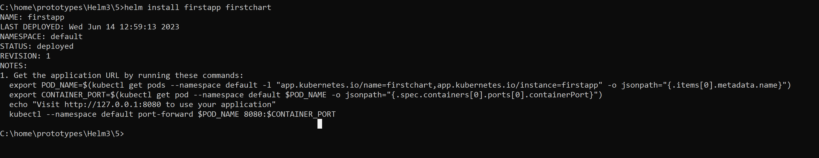
Install chart
Notes:
. Get the application URL by running these commands:
export POD_NAME=$(kubectl get pods --namespace default -l "app.kubernetes.io/name=firstchart,app.kubernetes.io/instance=firstapp" -o jsonpath="{.items[0].metadata.name}")
export CONTAINER_PORT=$(kubectl get pod --namespace default $POD_NAME -o jsonpath="{.spec.containers[0].ports[0].containerPort}")
echo "Visit http://127.0.0.1:8080 to use your application"
kubectl --namespace default port-forward $POD_NAME 8080:$CONTAINER_PORT

Slide 53
Helm package
Dependency updates
https://helm.sh/docs/chart_template_guide/helm_ignore_file/

Slide 54
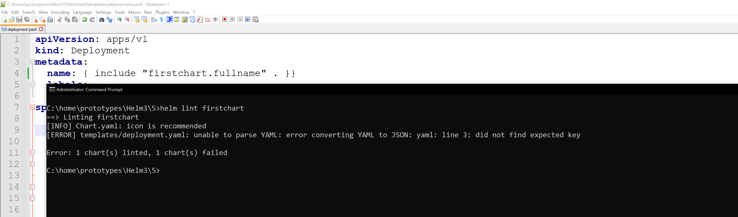
Helm lint - 1

Slide 55
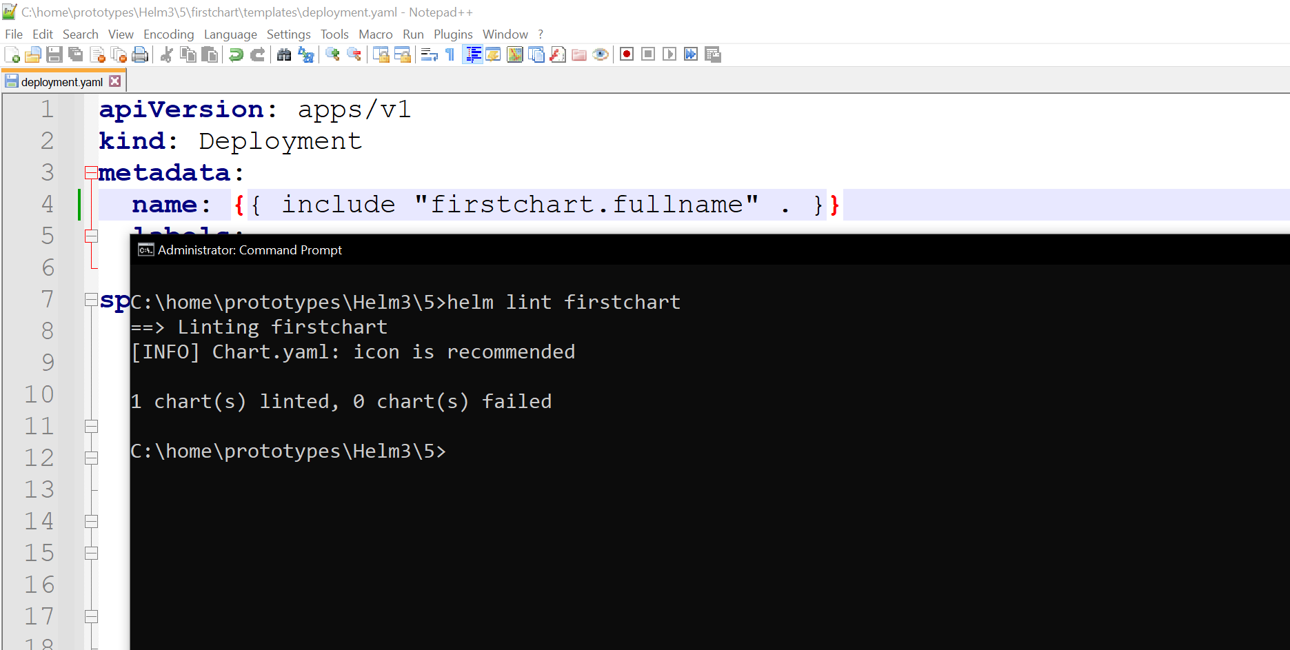
Helm lint - 2

Slide 56
TEMPLATE DEEP DIVE

Slide 57
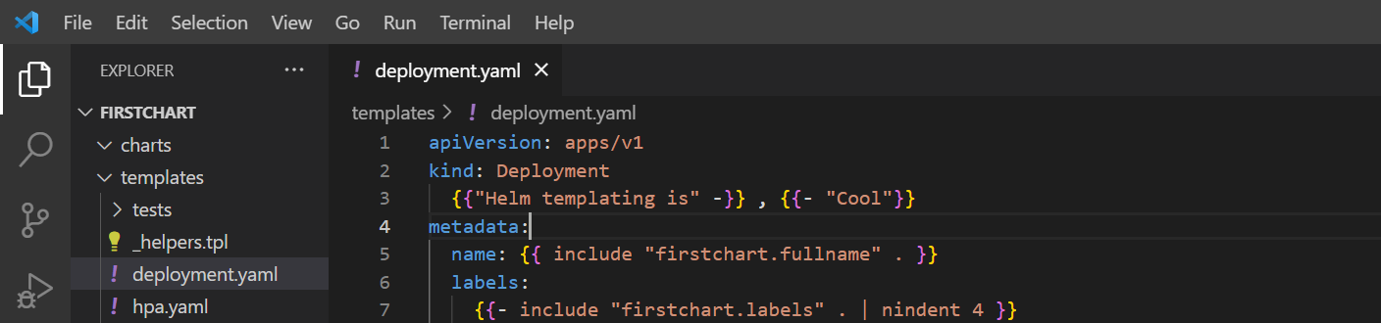

TEMPLATE ACTIONS - 1
Action starts with {{ and ends with }}
Remove trailing (leading and ending whitespaces).

Slide 58

TEMPLATE ACTIONS - 2

Slide 59


Template information - 1

Slide 60

Template information - 2

Slide 61

Template information - 3

Slide 62

Template information - 4

Slide 63

Pipeline - 1

Slide 64

Pipeline - 2

Slide 65

Pipeline 3

Slide 66

PIPLEINE 4

Slide 67
function
https://helm.sh/docs/chart_template_guide/function_list/

Slide 68

CONDITION LOGIC - 1

Slide 69

CONDITION LOGIC - 2

Slide 70

Condition logic - 3

Slide 71

Condition logic - 4

Slide 72

Condition logic - 5

Slide 73

Condition logic - 6

Slide 74

Use with - 1

Slide 75

Use with - 2

Slide 76

Use with - 3

Slide 77

Use with - 4
. points to values
$. points to Values

Slide 78

Use with - 5

Slide 79


DEFINE VARIABLES - 1

Slide 80

DEFINE VARIABLES - 2

Slide 81


DEFINE VARIABLES - 3

Slide 82


DEFINE VARIABLES - 4
The value test will never be assigned as
myFLAG was assigned as Boolean value

Slide 83


USE LOOPS - 1

Slide 84

USE LOOPS - 2

Slide 85


LOOP DICT TYPES

Slide 86

Debugging the template - 1
Remove brace

Slide 87


Debugging the template - 2

Slide 88

Debugging the template - 3

Slide 89


Debugging the template - 4

Slide 90


Debugging the template - 5

Slide 91


Debugging the template - 6

Slide 92


Debugging the template - 7
Dose not catch validation errors

Slide 93


Helm get manifest

Slide 94



Create and Use custom template - 1

Slide 95

Create and Use custom template - 2

Slide 96


Create and Use custom template - 3

Slide 97

Create and Use custom template - 4

Slide 98
Advance charts

Slide 99



Add dependencies - 1

Slide 100

Add dependencies - 2

Slide 101

Add dependencies - 3

Slide 102


DEPENDENCIES CONDITIONALLY - 1

Slide 103

DEPENDENCIES CONDITIONALLY - 2

Slide 104

DEPENDENCIES CONDITIONALLY - 3

Slide 105

DEPENDENCIES CONDITIONALLY - 4

Slide 106


USE multiple conditional dependencies - 1

Slide 107


USE multiple conditional dependencies - 2

Slide 108

USE multiple conditional dependencies - 3

Slide 109


USE multiple conditional dependencies - 4

Slide 110


Pass values to dependencies - 1

Slide 111


Pass values to dependencies - 2

Slide 112


Pass values to dependencies - 3

Slide 113



Use values not exported

Slide 114

CREATE AND USE HOOK - 1

Slide 115

CREATE AND USE HOOK - 2

Slide 116

TEST CHART - 1

Slide 117


TEST CHART - 2

Slide 118
repositories

Slide 119

Local repository

Slide 120

DOWNLOAD PYTHON

Slide 121



Python version

Slide 122


Use the repository - 1

Slide 123
Use the repository –2

Slide 124


HELM PULL

Slide 125

Install using helm pull

Slide 126

Update repositories - 1

Slide 127

Update repositories - 2

Slide 128

GITHUB Pages - 1

Slide 129

GITHUB Pages - 2

Slide 130


GITHUB Pages - 3

Slide 131

GITHUB Pages - 4

Slide 132

GITHUB Pages - 5

Slide 133

GITHUB Pages - 6

Slide 134

GITHUB Pages - 7

Slide 135

OCI REPOSITORIES - 1

Slide 136

OCI REPOSITORIES - 2

Slide 137

OCI REPOSITORIES - 3

Slide 138

OCI REPOSITORIES - 4

Slide 139

Chart security

Slide 140

PGP KEY INSTALLATION - 1

Slide 141

PGP KEY INSTALLATION - 2

Slide 142

PGP KEY INSTALLATION - 4

Slide 143


PGP KEY INSTALLATION - 5

Slide 144

PGP KEY INSTALLATION - 6

Slide 145
Use case

Slide 146

Create chart - 1
Delete above three files.

Slide 147

Create chart - 2
Delete above section,

Slide 148
Create chart - 3
Delete above section,

Slide 149

Create chart - 4
Delete above line,

Slide 150

Create chart - 5

Slide 151

deployment

Slide 152


service

Slide 153



Dependency - 1

Slide 154


Dependency - 2

Slide 155

Config map - 1

Slide 156

Config map - 2

Slide 157


Release and test - 1

Slide 158

Release and test - 2

Slide 159
starters

Slide 160
Create starters folder

Slide 161


Create a starter

Slide 162

Create chart using starter

Slide 163
PLUGINS

Slide 164

Helm starter

Slide 165

PLUGINS

Slide 166


Custom plugin - 1

Slide 167

Custom plugin - 2

